Slide 1
Add PHPmyAdmin to Laragon

Slide 2
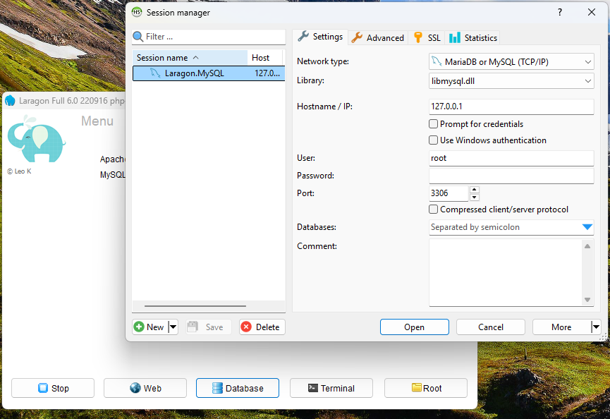
Open laragon
By default,
no phpmyadmin
You get this instead
when you click
”Database”
This is no good

Slide 3
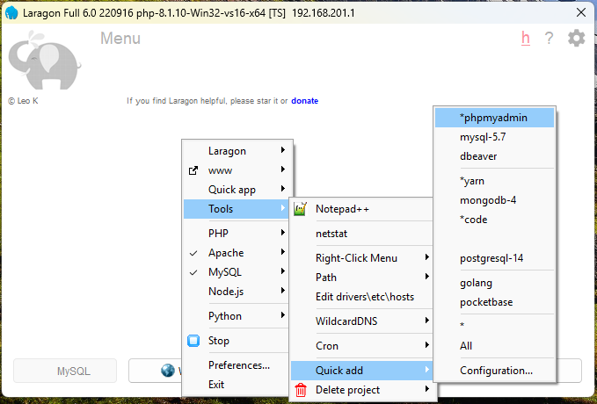
Right click to add
STOP ALL First
Use right click
on Laragon to
go to to this
menu option

Slide 4
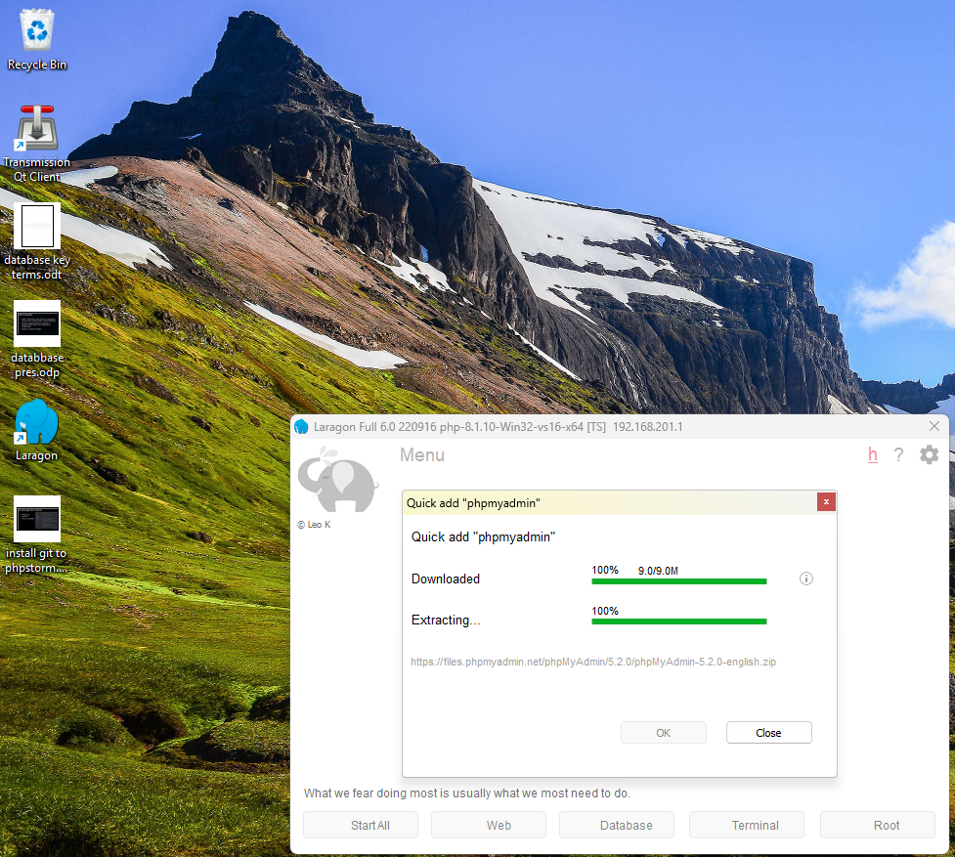
Allow it to install

Slide 5
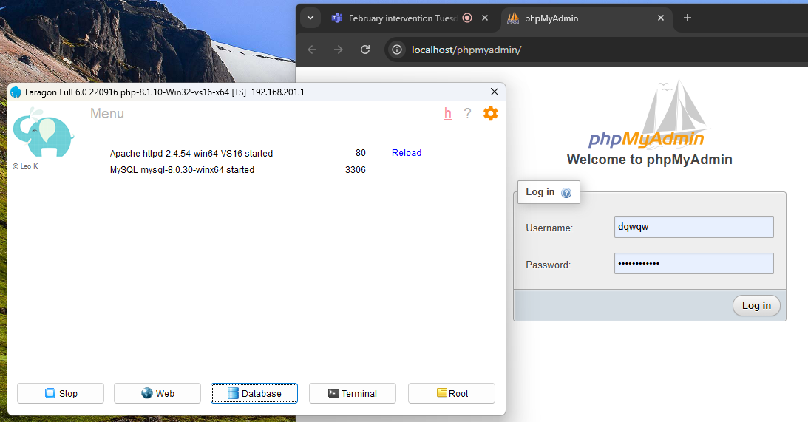
Start all
Click “start all”
Then click
Database
You now have
phpMyAdmin

